Slide 1
Classes 3, 4
Tariffs and Quotas by
Alan V. Deardorff
University of Michigan
2021
PubPol/Econ 541

Slide 2
Announcements
Quiz 1
  Available today after class
  Due Friday midnight
  Accepted until Saturday midnight with penalty
  Covers material on State of Play, 1 and 2
Suggestion for in-class responses:
  If you’ve already responded once, give time for others to respond
How to handle skipped slides

Slide 3
Pause for Discussion

Slide 4
  Questions from KOM
How do “specific” and “ad valorem” tariffs differ?
An import demand curve is sometimes called a “derived demand curve.” Why?
What is an “effective rate of protection”?

Slide 5
Outline
Tariff by Small country
Tariff by large country
Quotas
Recent tariff threats

Slide 6
Small country
Assumptions throughout
  Markets perfectly competitive
  Product homogeneous
  Markets in equilibrium
  There are no “distortions” (externalities, etc.)
  Supply and demand curves are linear
    Just for simplicity
  Model is partial equilibrium
  Model is static
  Free and frictionless trade

Slide 7
Small country
Special assumption for small country case
  World price is given (country too small to influence it)
  More correctly: country’s supply and demand in that industry too small to influence the world price

Slide 8
Small country, Import Industry
P
Effects of move from autarky to free trade
  Price falls
  Quantity supplied falls
  Quantity demanded rises
  Imports rise
Welfare effects:
  Suppliers lose −a
  Demanders gain +(a+b)
  Country gains +b
S=MC
P_{aut}
a
b
P₀=P_{W}
D=MB
S_{aut} =D_{aut}
S₀
D₀
Q
M₀
The Gain from Trade
Free trade

Slide 9
Small country tariff
P
Effects of a tariff, starting from free trade
  Price rises
  Quantity supplied rises
  Quantity demanded falls
  Quantity of imports falls
  Tariff revenue rises from zero
S=MC
P_{aut}
P₁=P_{W}+t
t
P₀=P_{W}
M₁
D=MB
S₀
S₁
D₁
D₀
Q
M₀
Specific Tariff t

Slide 10
Small country tariff
WHY?
P
Welfare effects of a tariff, starting from free trade
  Suppliers gain +a
  Demanders Lose −(a+b+c+d)
  Government gains +c
  Country loses −(b+d)
S=MC
WHY?
P_{aut}
P₁=P_{W}+t
t
a
c
b
d
P₀=P_{W}
“Dead Weight Loss” =
M₁
D=MB
S₀
S₁
D₁
D₀
Q
M₀
Specific Tariff t

Slide 11
Small country tariff
P
Welfare effects of a tariff, starting from free trade
  Suppliers gain +a
  Demanders Lose −(a+b+c+d)
  Government gains +c
  Country loses −(b+d)
S=MC
P_{aut}
P₁=P_{W}+t
t
a
c
b
d
P₀=P_{W}
“Dead Weight Loss” =
M₁
D=MB
S₀
S₁
D₁
D₀
Q
M₀
Specific Tariff t

Slide 12
Pause for Discussion

Slide 13
  Questions on Graph
If a price falls, why does the gain to demanders not equal the fall in what they pay? Is it larger than this or smaller?
If a price rises, why is the gain to suppliers not their rise in revenue? Is it larger or smaller?
In what sense does a small country gain by eliminating a tariff? Does anybody in the country lose?

Slide 14
Small country, larger tariff
P
Effects of doubling the tariff
  Price rises by twice as much
  Imports fall by twice as much
  Deadweight loss is 4-times as large!
    (Efficiency loss rises with the square of the tariff)
S=MC
P_{aut}
P₂=P_{W}+2t
P₁=P_{W}+t
P₁=P_{W}+t
t
P₀=P_{W}
M₂
M₁
D=MB
S₀
D₀
S₁
M₀
D₁
Q
Specific Tariffs, t, then 2t

Slide 15
Small country, prohibitive tariff
NOTE: You’ll have to calculate this from supply and demand
P
Welfare effects of a prohibitive tariff, starting from free trade
  Suppliers gain +a
  Demanders Lose −(a+b+d)
  Government gains 0
  Country loses −(b+d)
P_{W}+t_{P} ≠ P₁
S=MC
P₁=
P_{aut}
t_{P}
a
b
d
P₀=P_{W}
“Dead Weight Loss” =
D=MB
S₀
S₁
D₁
D₀
Q
M₀
( M₁=0 )
Specific Tariff t_{P} > P_{aut} − P_{W}

Slide 16
Comparative Statics with Tariff
Fall in World Price
P
S=MC
P_{aut}
P₀=P_{W}+t
Tariff causes same dead-weight loss (with linear S&D)
t
P₁=P’_{W}+t
P_{W}
t
P’_{W}
M₁
D=MB
S₁
S₀
D₀
D₁
Q
M₀

Slide 17
Comparative Statics with Tariff
Fall in World Price
P
Welfare effects of a fall in world price in presence of specific tariff
  Suppliers lose –a
  Demanders gain +(a+b+c+d)
  Government gains +(e+f)
  Country gains +(b+c+d+e+f)
S=MC
P_{aut}
P₀=P_{W}+t
t
a
b
c
d
P₁=P’_{W}+t
P_{W}
t
e
f
P’_{W}
M₁
D=MB
S₁
S₀
D₀
D₁
Q
M₀

Slide 18
Pause for
Your Questions

Slide 19
Pause for Discussion

Slide 20
  Questions on Tariff Analysis
Why does Lahart say the measurement of harm from tariffs is an “imperfect science”?
Lahart cited an estimate of loss from Trump’s tariffs and retaliation of 1.3% of GDP. Is this big?
What effects of tariffs are missing from the welfare effects of tariffs?

Slide 21
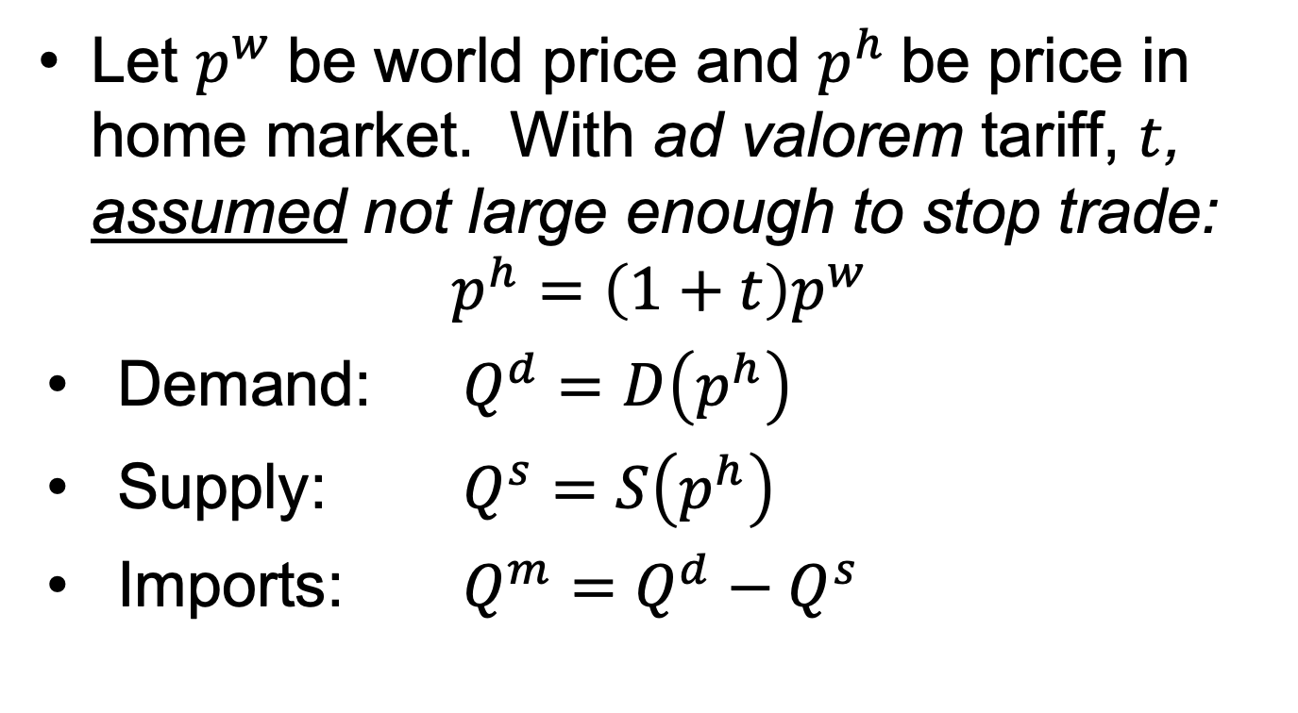
Small Country in Equations
Let $p^{w}$be world price and $p^{h}$be price in home market. With ad valorem tariff, $t$, assumed not large enough to stop trade:
$$p^{h}=\left(1+t\right)p^{w}$$
Demand: $Q^{d}=D\left(p^{h}\right)$
Supply: $Q^{s}=S\left(p^{h}\right)$
Imports: $Q^{m}=Q^{d}−Q^{s}$
NOTE: Used specific tariff in graphs,
ad valorem
in eqns.
Both are for simplicity.

Slide 22
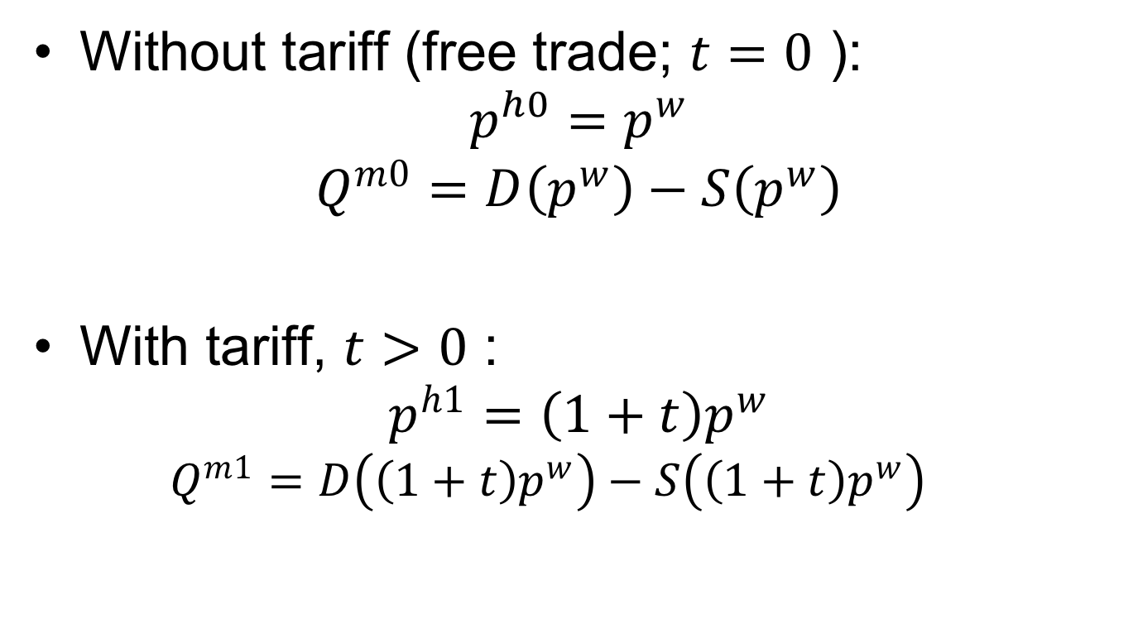
Small Country in Equations
Without tariff (free trade; $t=0$ ):
$$p^{h0}=p^{w}$$
$$Q^{m0}=D\left(p^{w}\right)−S\left(p^{w}\right)$$
With tariff, $t>0$ :
$$p^{h1}=\left(1+t\right)p^{w}$$
  $$Q^{m1}=D\left(\left(1+t\right)p^{w}\right)−S\left(\left(1+t\right)p^{w}\right)$$

Slide 23
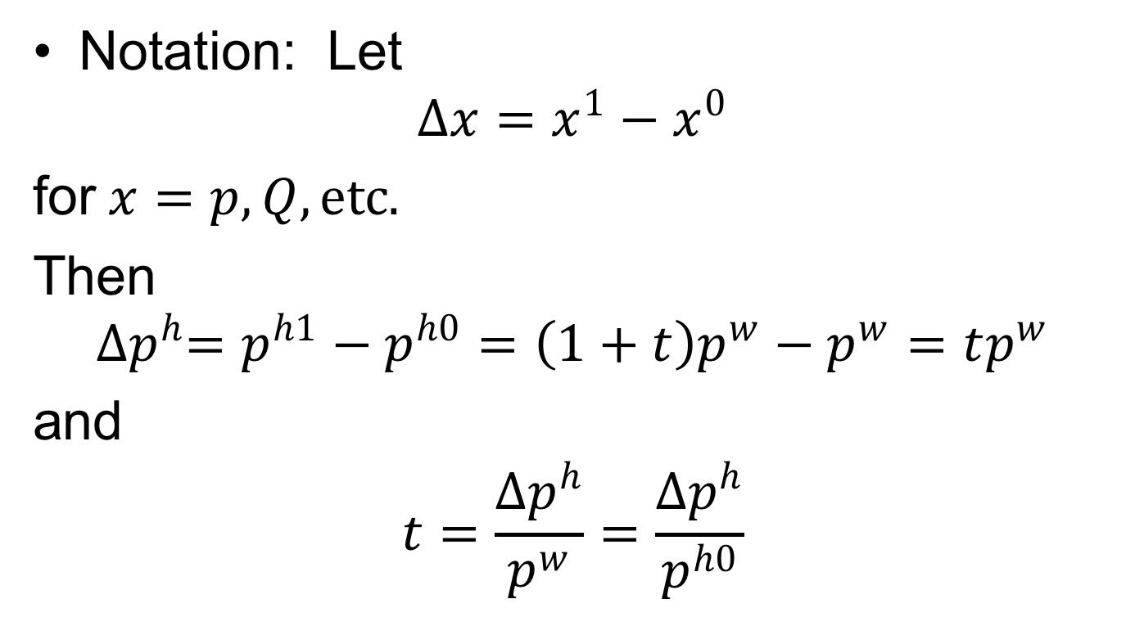
Small Country in Equations
Notation: Let
$$∆x=x^{1}−x^{0}$$
for$x=p, Q, etc.$
Then
$${∆p}^{h}=p^{h1}−p^{h0}=\left(1+t\right)p^{w}−p^{w}=tp^{w}$$
and
$$t=\frac{{∆p}^{h}}{p^{w}}=\frac{{∆p}^{h}}{p^{h0}}$$

Slide 24
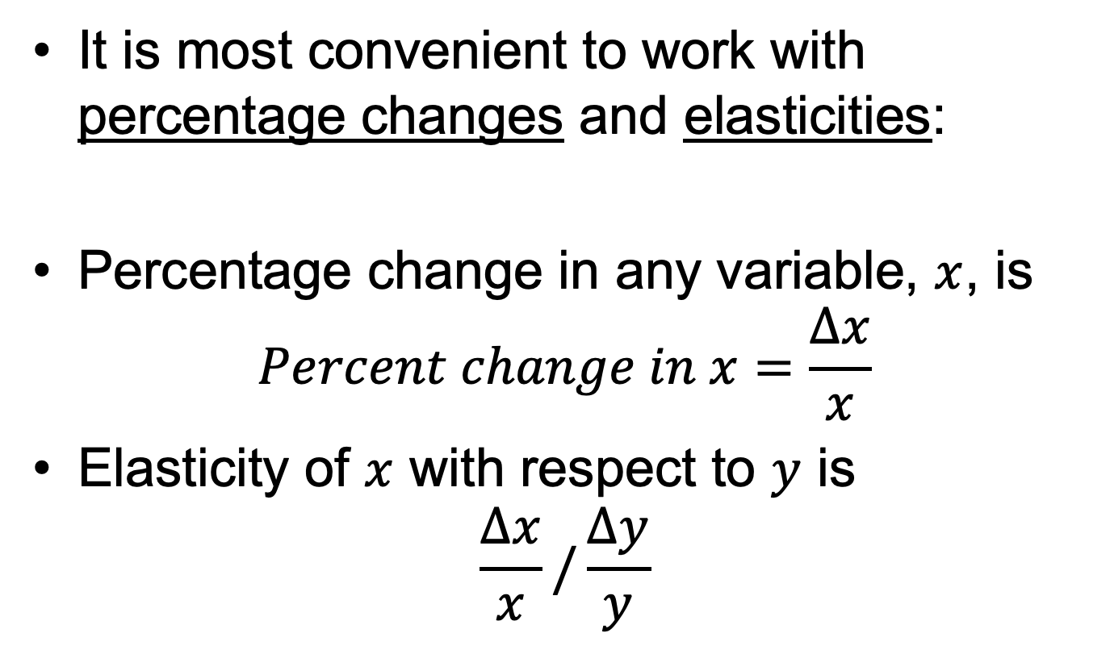
Small Country in Equations
It is most convenient to work with percentage changes and elasticities:
Percentage change in any variable, $x$, is
$$Percent change in x=\frac{∆x}{x}$$
Elasticity of $x$ with respect to $y$ is
$$\frac{∆x}{x}/\frac{∆y}{y}$$

Slide 25
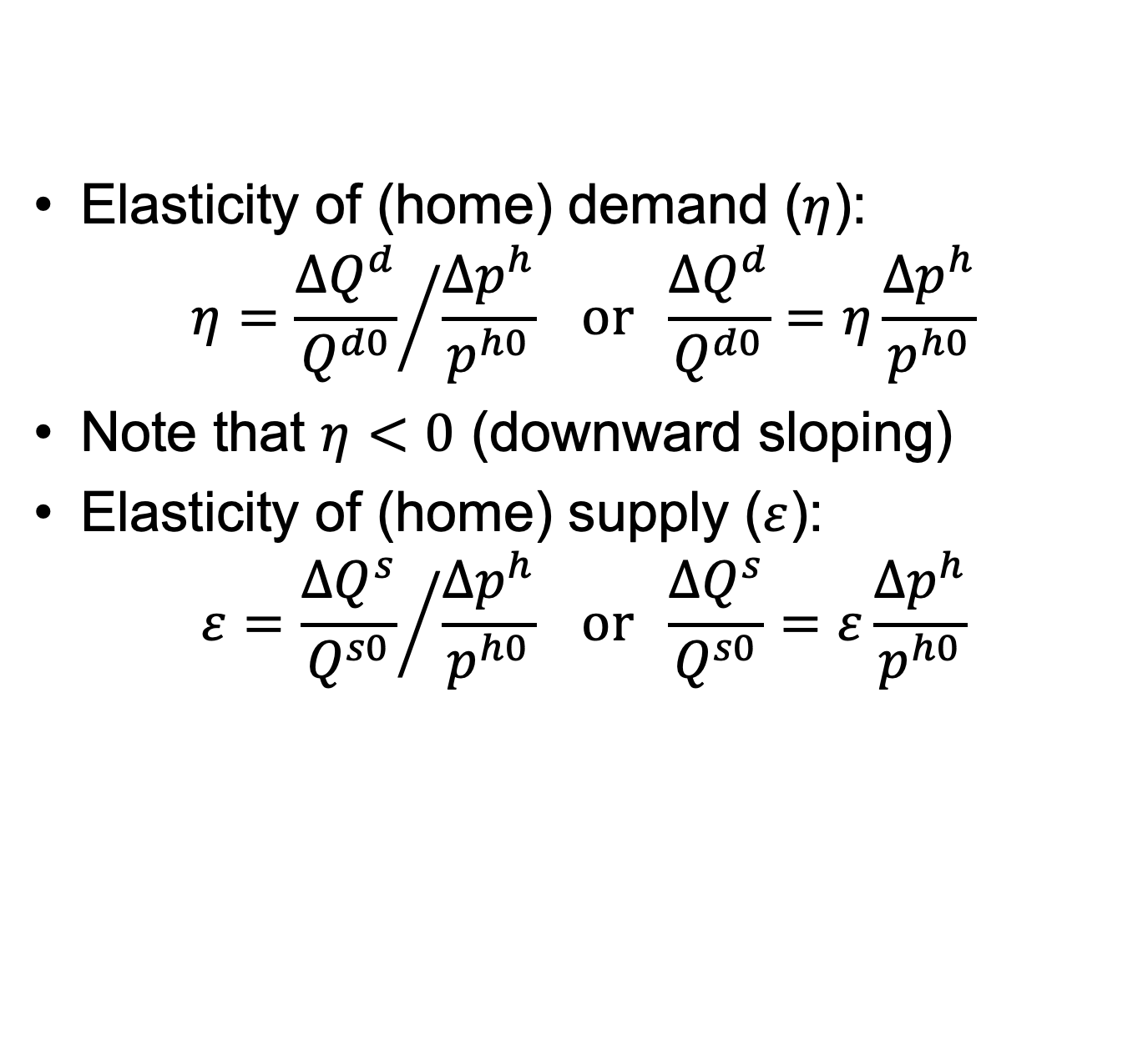
Small Country in Equations
Elasticity of (home) demand ($η$):
$$η={\frac{{∆Q}^{d}}{Q^{d0}}}/{\frac{{∆p}^{h}}{p^{h0}}} or \frac{{∆Q}^{d}}{Q^{d0}}=η\frac{{∆p}^{h}}{p^{h0}}$$
Note that $η<0$ (downward sloping)
Elasticity of (home) supply ($ε$):
$$ε={\frac{{∆Q}^{s}}{Q^{s0}}}/{\frac{{∆p}^{h}}{p^{h0}}} or \frac{{∆Q}^{s}}{Q^{s0}}=ε\frac{{∆p}^{h}}{p^{h0}}$$
When you know the price change, use these to find the quantity change

Slide 26
Small Country in Equations
Notes regarding elasticities:
  They’ll be defined here as changes relative to the free-trade quantities and prices.
  Different, but just as valid, would be changes relative to quantities and prices in the presence of the tariff.
  Answers will differ, but by much less than our uncertainty about the values of elasticities.
  In your calculations, use whichever is most convenient, but be consistent.

Slide 27
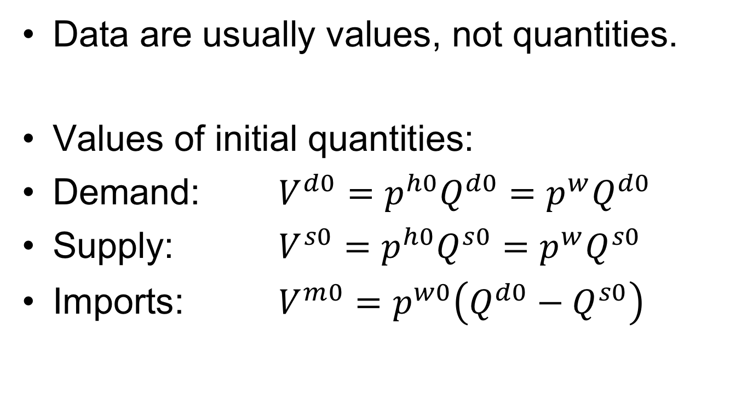
Small Country in Equations
Data are usually values, not quantities.
Values of initial quantities:
Demand: $V^{d0}=p^{h0}Q^{d0}=p^{w}Q^{d0}$
Supply: $V^{s0}=p^{h0}Q^{s0}=p^{w}Q^{s0}$
Imports: $V^{m0}=p^{w0}\left({Q^{d0}−Q}^{s0}\right)$

Slide 28
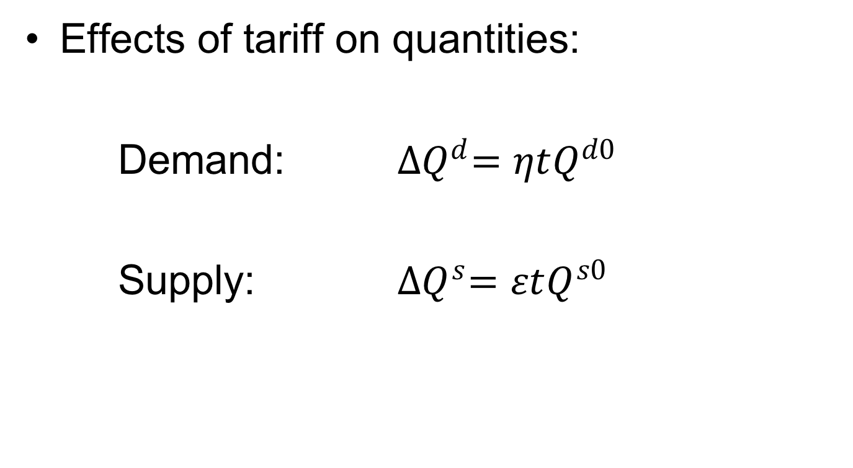
Small Country in Equations
Effects of tariff on quantities:
Demand: ${∆Q}^{d}=ηtQ^{d0}$
Supply: ${∆Q}^{s}=εtQ^{s0}$

Slide 29
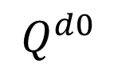
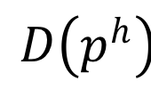
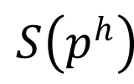
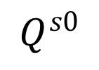
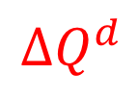
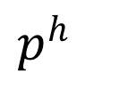

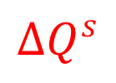
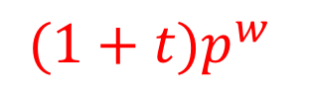


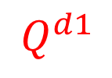

$p^{h}$
$$S\left(p^{h}\right)$$
${(1+t)p}^{w}$
e
$${∆p}^{h}={tp}^{w}$$
a
c
b
d
$p^{w}$
$$D\left(p^{h}\right)$$
$${∆Q}^{s}$$
$${∆Q}^{d}$$
$$Q^{s0}$$
$$Q^{s1}$$
$$Q^{d1}$$
$$Q^{d0}$$
$$Q$$
I’ll use $〈a〉$, $〈abcd〉, etc.$to represent these areas.

Slide 30





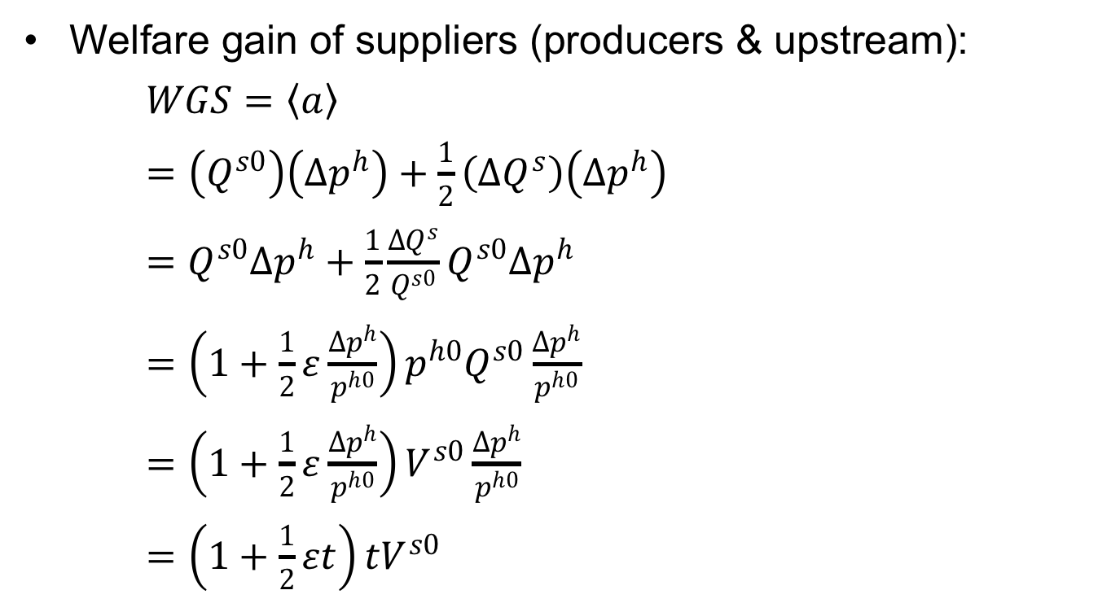








Small Country in Equations
Welfare gain of suppliers (producers & upstream):
$WGS=〈a〉$
$=\left(Q^{s0}\right)\left({∆p}^{h}\right)+\frac{1}{2}\left({∆Q}^{s}\right)\left({∆p}^{h}\right)$
$=Q^{s0}{∆p}^{h}+\frac{1}{2}\frac{{∆Q}^{s}}{Q^{s0}}Q^{s0}{∆p}^{h}$
$={\left(1+\frac{1}{2}ε\frac{{∆p}^{h}}{p^{h0}}\right)p^{h0}Q}^{s0}\frac{{∆p}^{h}}{p^{h0}}$
$=\left(1+\frac{1}{2}ε\frac{{∆p}^{h}}{p^{h0}}\right)V^{s0}\frac{{∆p}^{h}}{p^{h0}}$
$=\left(1+\frac{1}{2}εt\right){tV}^{s0}$
$p^{h}$
$$S\left(p^{h}\right)$$
${(1+t)p}^{w}$
$${∆p}^{h}={tp}^{w}$$
a
c
e
b
d
$p^{w}$
$$D\left(p^{h}\right)$$
$${∆Q}^{s}$$
$${∆Q}^{d}$$
$$Q^{s0}$$
$$Q^{s1}$$
$$Q^{d1}$$
$$Q^{d0}$$
$$Q$$

Slide 31
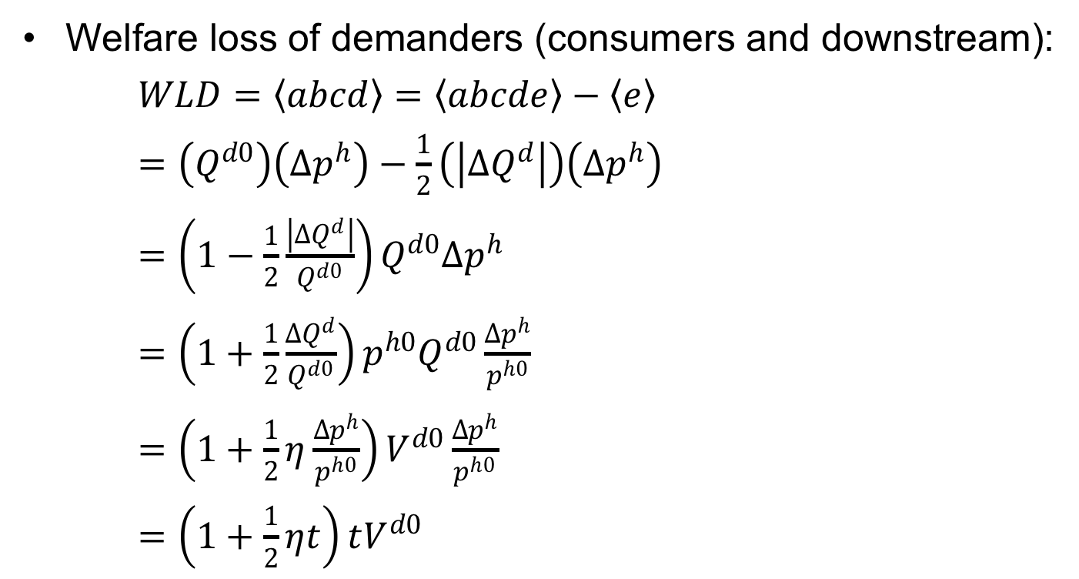
Small Country in Equations
Welfare loss of demanders (consumers and downstream):
$WLD=〈abcd〉=〈abcde〉−〈e〉$
$=\left(Q^{d0}\right)\left({∆p}^{h}\right)−\frac{1}{2}\left(\left|{∆Q}^{d}\right|\right)\left({∆p}^{h}\right)$
$=\left(1−\frac{1}{2}\frac{\left|{∆Q}^{d}\right|}{Q^{d0}}\right)Q^{d0}{∆p}^{h}$
$=\left(1+\frac{1}{2}\frac{{∆Q}^{d}}{Q^{d0}}\right){p^{h0}Q}^{d0}\frac{{∆p}^{h}}{p^{h0}}$
$=\left(1+\frac{1}{2}η\frac{{∆p}^{h}}{p^{h0}}\right)V^{d0}\frac{{∆p}^{h}}{p^{h0}}$
$=\left(1+\frac{1}{2}ηt\right)tV^{d0}$
$p^{h}$
$$S\left(p^{h}\right)$$
${(1+t)p}^{w}$
$${∆p}^{h}={tp}^{w}$$
a
c
e
b
d
$p^{w}$
$$D\left(p^{h}\right)$$
$${∆Q}^{s}$$
$${∆Q}^{d}$$
$$Q^{s0}$$
$$Q^{s1}$$
$$Q^{d1}$$
$$Q^{d0}$$
$$Q$$

Slide 32
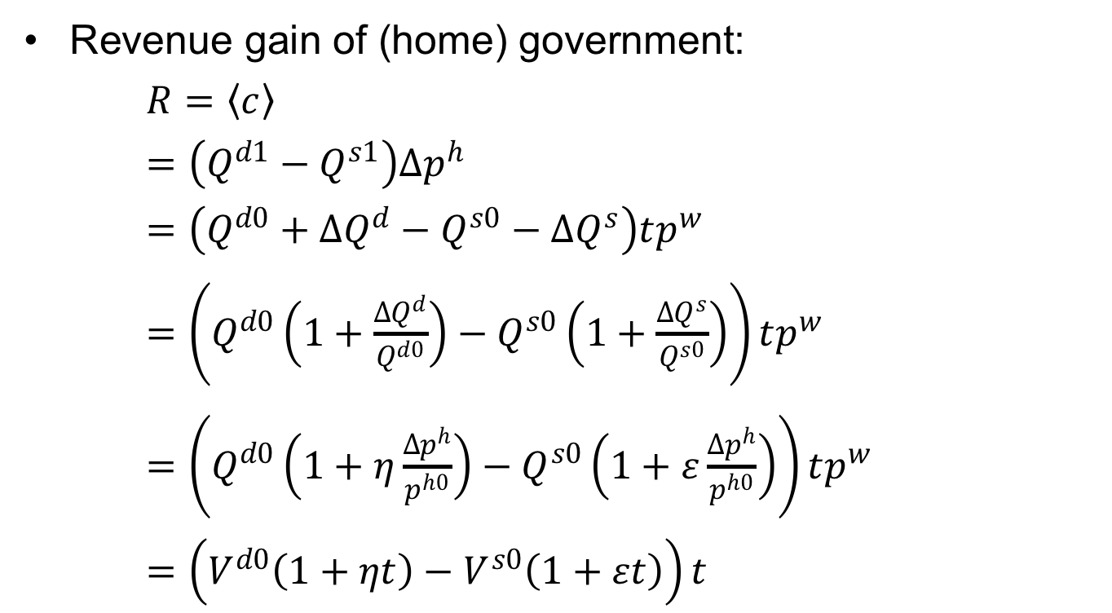
Small Country in Equations
$p^{h}$
$$S\left(p^{h}\right)$$
Revenue gain of (home) government:
$R=〈c〉$
$=\left(Q^{d1}−Q^{s1}\right){∆p}^{h}$
$=\left(Q^{d0}+{∆Q}^{d}−Q^{s0}−{∆Q}^{s}\right)tp^{w}$
$=\left(Q^{d0}\left(1+\frac{{∆Q}^{d}}{Q^{d0}}\right)−Q^{s0}\left(1+\frac{{∆Q}^{s}}{Q^{s0}}\right)\right)tp^{w}$
$=\left(Q^{d0}\left(1+η\frac{{∆p}^{h}}{p^{h0}}\right)−Q^{s0}\left(1+ε\frac{{∆p}^{h}}{p^{h0}}\right)\right)tp^{w}$
$=\left(V^{d0}\left(1+ηt\right)−V^{s0}\left(1+εt\right)\right)t$
${(1+t)p}^{w}$
$${∆p}^{h}={tp}^{w}$$
a
c
e
b
d
$p^{w}$
$$D\left(p^{h}\right)$$
$${∆Q}^{s}$$
$${∆Q}^{d}$$
$$Q^{s0}$$
$$Q^{s1}$$
$$Q^{d1}$$
$$Q^{d0}$$
$$Q$$

Slide 33



Small Country in Equations
$p^{h}$
$$S\left(p^{h}\right)$$
Welfare change for country:
$WCC=−〈abcd〉+〈a〉+〈c〉$
$=WLD−WGS−R$
$$=−\left(1+\frac{1}{2}ηt\right)tV^{d0}+\left(1+\frac{1}{2}εt\right){tV}^{s0}+\left(V^{d0}\left(1+ηt\right)−V^{s0}\left(1+εt\right)\right)t$$
${(1+t)p}^{w}$
$${∆p}^{h}={tp}^{w}$$
a
c
e
b
d
$p^{w}$
$$D\left(p^{h}\right)$$
$${∆Q}^{s}$$
$${∆Q}^{d}$$
$$Q^{s0}$$
$$Q^{s1}$$
$$Q^{d1}$$
$$Q^{d0}$$
$$Q$$
$=−tV^{d0}+{tV}^{s0}−\frac{1}{2}ηt^{2}V^{d0}+\frac{1}{2}εt^{2}V^{s0}+{tV}^{d0}−tV^{s0}$
$$+ηt^{2}V^{d0}−{εt}^{2}V^{s0}$$
$$=−\left[\frac{1}{2}εt^{2}V^{s0}−\frac{1}{2}ηt^{2}V^{d0}\right]$$

Slide 34
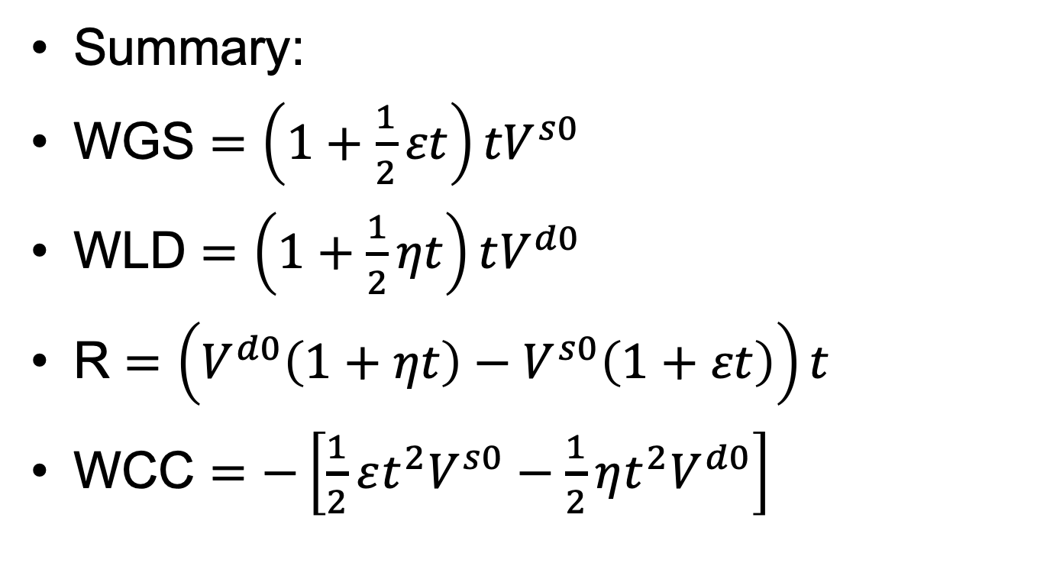
Small Country in Equations
WGS = Welfare Gain of Suppliers
WLD = Welfare Loss of Demanders
R = Government Revenue
WCC = Welfare Change of Country
Summary:
WGS $=\left(1+\frac{1}{2}εt\right){tV}^{s0}$
WLD $=\left(1+\frac{1}{2}ηt\right)tV^{d0}$
R $=\left(V^{d0}\left(1+ηt\right)−V^{s0}\left(1+εt\right)\right)t$
WCC $=−\left[\frac{1}{2}εt^{2}V^{s0}−\frac{1}{2}ηt^{2}V^{d0}\right]$

Slide 35
Pause for Discussion

Slide 36
  Questions on Equations
What information do you need to calculate these welfare effects?
How do they change with larger tariffs?
Explain the sources of the “production distortion loss” and the “consumption distortion loss.”
  Why does each occur, and who is it that loses in each case?
  Where do these appear in the equations?

Slide 37
Outline
Small country
Large country

Slide 38
Large country
(i.e., Two Countries)
Home
Foreign (*)
P
P*
S
S*
P_{aut}
D*
D
P*_{aut}
Q
Q*
Autarky

Slide 39
Large country
(i.e., Two Countries)
Home
World
Foreign
P
P
P*
S
XS*
S*
P_{aut}
D*
D
P*_{aut}
MD
Q
M₀=X*₀
M,X*
Q*
Free trade

Slide 40
Large country
(i.e., Two Countries)
Home
World
Foreign
P
P
P*
S
XS*
S*
P_{aut}
D*
P_{W0}
P*₀=P_{W0}
P₀=P_{W0}
D
P*_{aut}
MD
S₀
D₀
Q
M₀=X*₀
M,X*
D*₀
S*₀
Q*
M₀
X*₀
Free trade

Slide 41
Large country
(i.e., Two Countries)
Home
World
Foreign
P
P
P*
S
XS*
S*
P₁
D*
P₁
P₀=P_{W0}
t
P*₁
P*₁
D
M₁=X*₁
MD
M₁
X*₁
S₀
D₀
Q
M₀=X*₀
M,X*
D*₀
S*₀
Q*
M₀
X*₀
S₁
D₁
D*₁
S*₁
Specific Tariff, t, by Home
Requires: P=P*+t, MD=XS*

Slide 42
Large country (i.e., Two Countries)
Home
World
Foreign
P
P
P*
S
XS*
S*
P₁
D*
P₁
t
a
c
t
c
P₀=P_{W0}
b
d
f
e
g
i
j
P*₁
e
h
e
P*₁
P*₁
D
MD
S₀
D₀
Q
M₀=X*₀
M,X*
D*₀
S*₀
Q*
S₁
D₁
D*₁
S*₁
Welfare effects of Tariff, t:
Foreign
  Suppliers −(h+i+e+j)
  Demanders +h
  Country −(i+e+j) = −(e+g)
Home
  Suppliers +a
  Demanders –(a+b+c+d)
  Government +(c+e)
  Country +e−(b+d) = e−f
  World: −(f+g) = −(b+d+i+j)
Classes 3, 4: Tariffs and Quotas

Slide 43
Large country, World Market
Welfare effects of a large-country tariff, starting from free trade
Home:
  Private sector (S&D) loses −(a+b)
  Government gains +(a+c)
  Country may gain or lose: +c−b
Foreign
  Private sector (S&D) loses −(c+d)
World loses −(b+d)
World Market
Home is Importer
Foreign (*) is Exporter
P
XS*
P₁
a
b
t
c
d
P*₁
MD
M₁=X*₁
M₀=X*₀
M,X*
“Dead Weight Loss” =

Slide 44
Large country, World Market
Thus large country will gain from tariff if c>b
What is area c?
  The portion of the tariff paid by foreign exporters, who get a lower price
  A transfer from foreign producers to the home government
  The result of improving the home country’s “terms of trade”
World Market
Home is Importer
Foreign (*) is Exporter
P
XS*
P₁
a
b
t
c
d
P*₁
MD
M₁=X*₁
M₀=X*₀
M,X*
“Terms of Trade” ≡ Relative price of exports = P^{X}/P^{M}

Slide 45
Pause for Discussion

Slide 46
  Questions on Large Country
The figure for the world market shows the tariff causing the world price to fall. What in the figure tells you that the Home country is large?
In what sense might a large country gain by using a tariff? Who in the country benefits from that gain?
What reasons are there, if any, for a large country not to levy a tariff?

Slide 47
Large country, “Optimal” tariff
Watch as t rises
Welfare
P
P_{aut}
b
XS*
c
P₁
t
b
P*₁
c
t
MD
P_{aut}*
M₁=X*₁
M₀=X*₀
M,X*
P_{aut}–P_{aut}*

Slide 48
Large country, “Optimal” tariff
Watch as t rises
Welfare
P
P_{aut}
b
XS*
c
P₁
a
b
t
c
d
t
P*₁
MD
P_{aut}*
M₁=X*₁
M₀=X*₀
M,X*
P_{aut}–P_{aut}*

Slide 49
Welfare
P
P_{aut}
b
XS*
c
P₁
t
b
c
t_{opt}
t
P*₁
MD
P_{aut}*
c–b
M₁=X*₁
M₀=X*₀
M,X*
P_{aut}–P_{aut}*

Slide 50
How Sizes and Slopes Matter
Home
World
Foreign
P
P
P*
S
XS*
S*
P_{aut}
D*
P_{W0}
P*₀=P_{W0}
P₀=P_{W0}
D
P*_{aut}
MD
S₀
D₀
Q
M₀=X*₀
M,X*
D*₀
S*₀
Q*
M₀
X*₀
Free trade
Tariff

Slide 51
How Slopes (Elasticities) Matter
Home
World
Foreign
P
P
P*
S
P_{aut}
XS*
S*
D*
P_{W0}
P*₀=P_{W0}
P₀=P_{W0}
D
P*_{aut}
MD
S₀
D₀
Q
M₀=X*₀
M,X*
D*₀
S*₀
Q*
M₀
X*₀
Free trade
Tariff

Slide 52
How Sizes Matter
Home
World
Foreign
P
P
P*
S
XS*
D*
S*
P_{aut}
P₀=P_{W0}
P*₀=P_{W0}
P_{W0}
P*_{aut}
D
MD
S₀
D₀
Q
M,X*
D*₀
S*₀
Q*
M₀
M₀=X*₀
X*₀
Free trade
Tariff

Slide 53
Pause for Your Questions

Slide 54
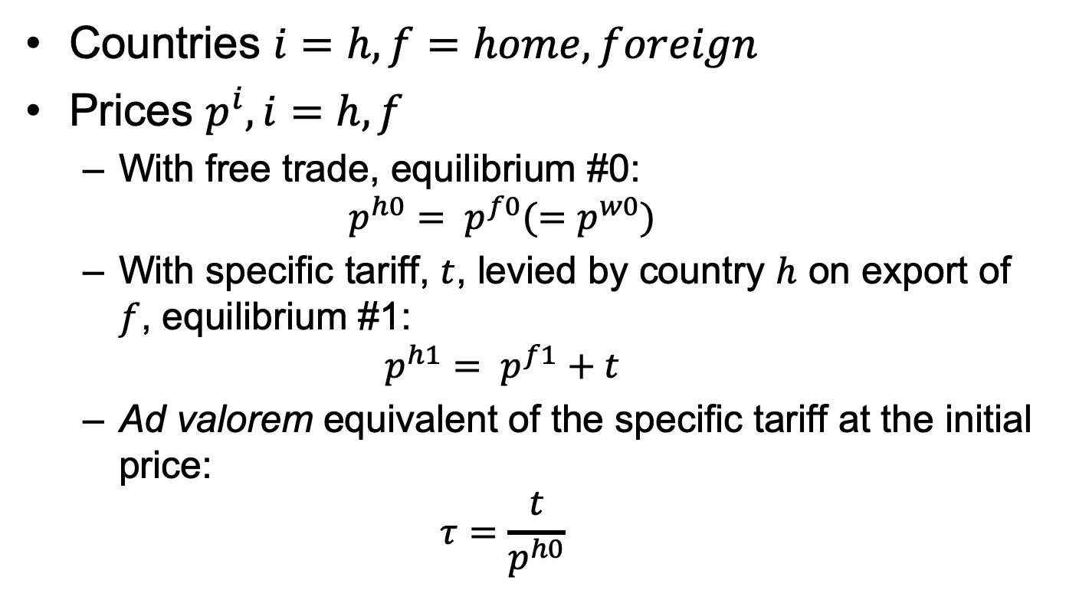
Two-Country in Equations
Countries $i=h, f=home, foreign$
Prices $p^{i}, i=h, f$
  With free trade, equilibrium #0:
  $$p^{h0}= p^{f0}(=p^{w0})$$
  With specific tariff, $t$, levied by country $h$ on export of $f$, equilibrium #1:
  $$p^{h1}= p^{f1}+t$$
  Ad valorem equivalent of the specific tariff at the initial price:
  $$τ=\frac{t}{p^{h0}}$$

Slide 55
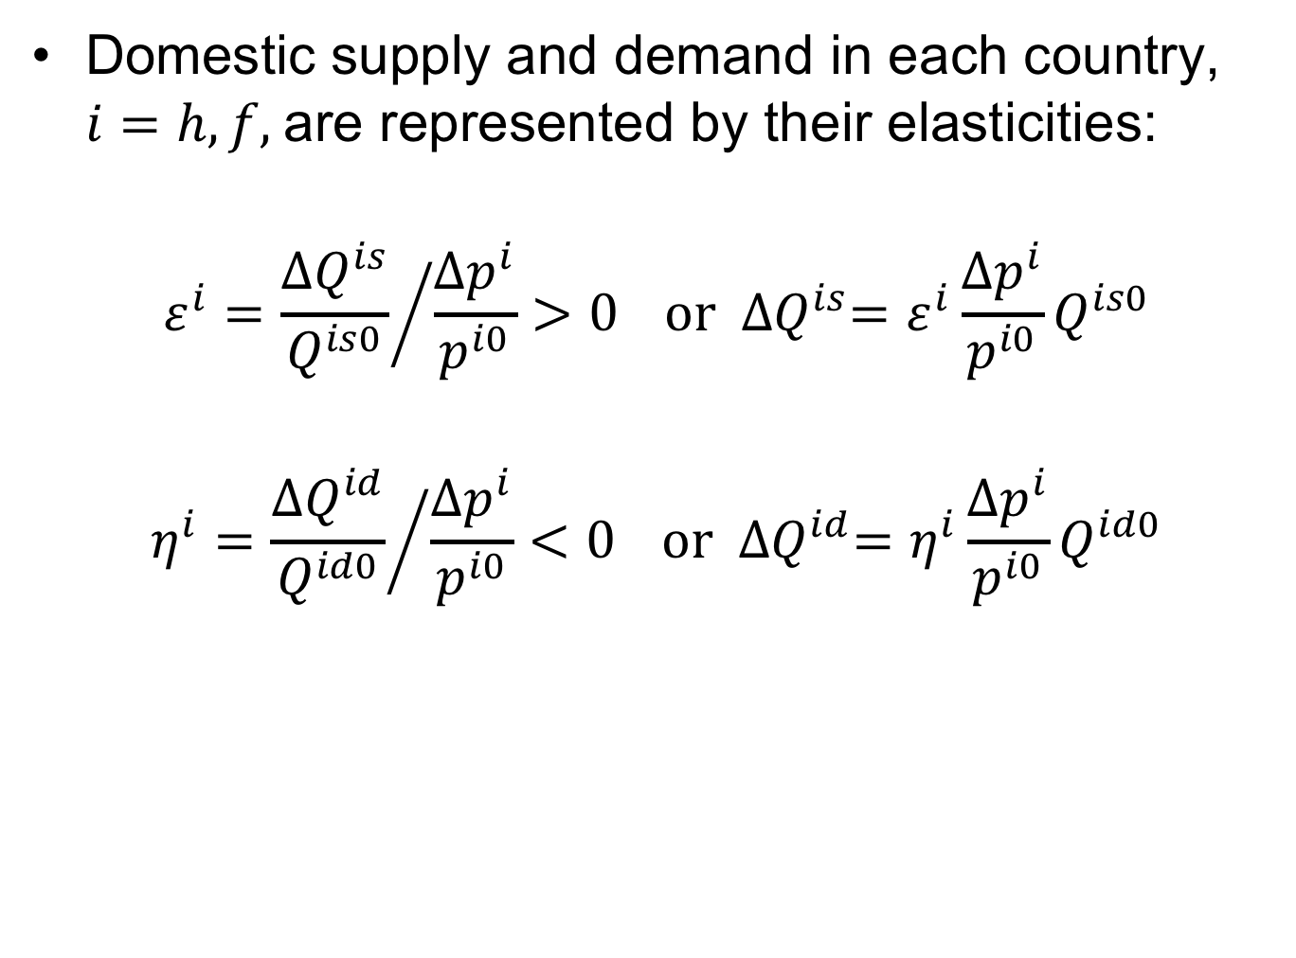
Two-Country in Equations
Domestic supply and demand in each country, $i=h, f,$are represented by their elasticities:
$$ε^{i}={\frac{{∆Q}^{is}}{Q^{is0}}}/{\frac{{∆p}^{i}}{p^{i0}}>0} or {∆Q}^{is}=ε^{i}\frac{{∆p}^{i}}{p^{i0}}Q^{is0}$$
$$η^{i}={\frac{{∆Q}^{id}}{Q^{id0}}}/{\frac{{∆p}^{i}}{p^{i0}}<0} or {∆Q}^{id}=η^{i}\frac{{∆p}^{i}}{p^{i0}}Q^{id0}$$

Slide 56
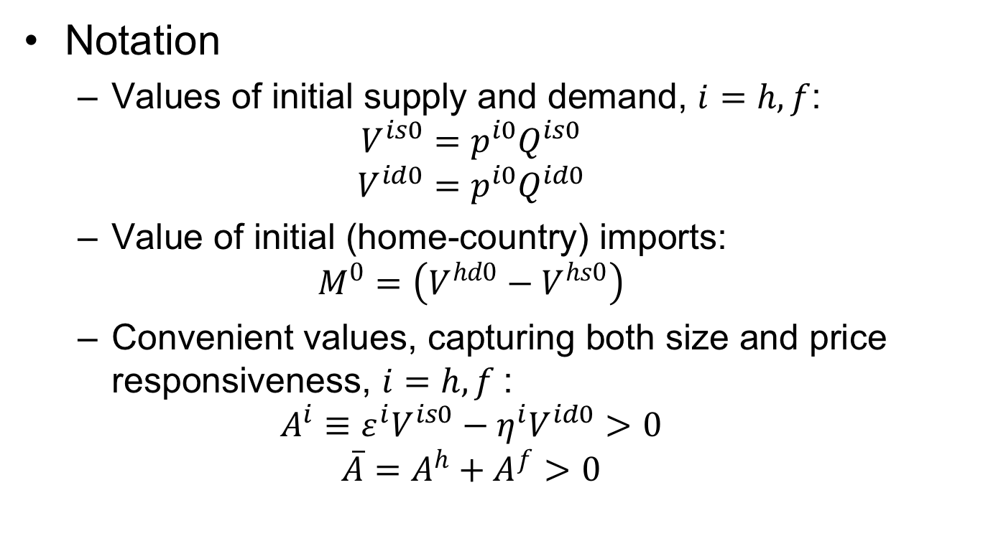
Two-Country in Equations
Notation
  Values of initial supply and demand, $i=h, f$:
  $$V^{is0}=p^{i0}Q^{is0}$$
  $$V^{id0}=p^{i0}Q^{id0}$$
  Value of initial (home-country) imports:
  $$M^{0}=\left(V^{hd0}−V^{hs0}\right)$$
  Convenient values, capturing both size and price responsiveness, $i=h, f$:
  $$A^{i}≡ε^{i}V^{is0}−η^{i}V^{id0}>0$$
  $${\overline{A}=A}^{h}+A^{f}>0$$

Slide 57
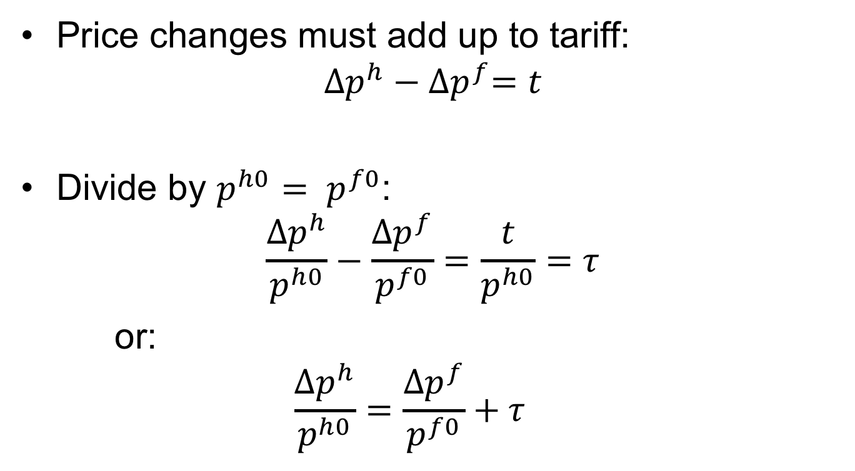
Two-Country in Equations
Price changes must add up to tariff:
$${∆p}^{h}−{∆p}^{f}=t$$
Divide by $p^{h0}= p^{f0}$:
$$\frac{{∆p}^{h}}{p^{h0}}−\frac{{∆p}^{f}}{p^{f0}}=\frac{t}{p^{h0}}=τ$$
or:
  $$\frac{{∆p}^{h}}{p^{h0}}=\frac{{∆p}^{f}}{p^{f0}}+τ$$

Slide 58

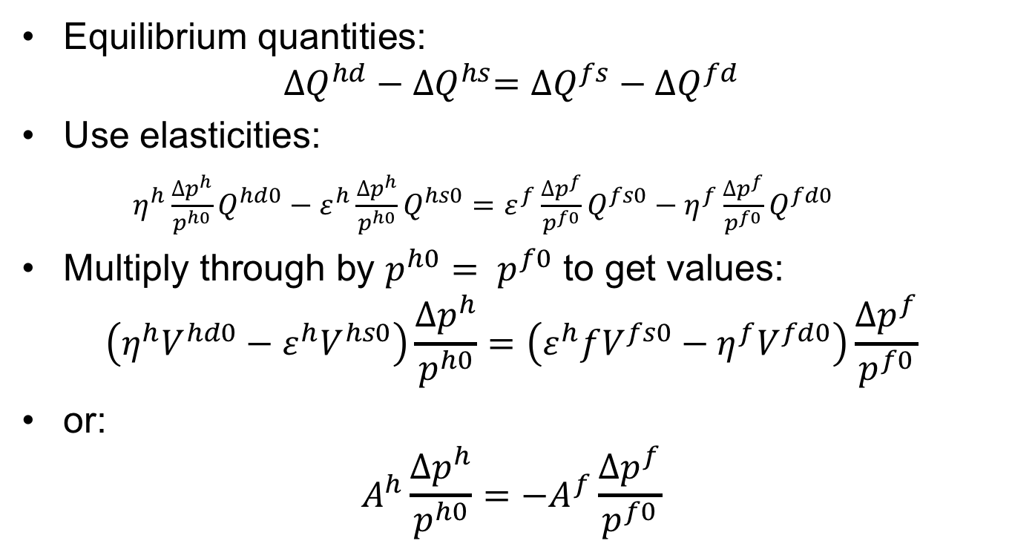
Two-Country in Equations
Equilibrium quantities:
$${∆Q}^{hd}−{∆Q}^{hs}={∆Q}^{fs}−{∆Q}^{fd}$$
Use elasticities:
$η^{h}\frac{{∆p}^{h}}{p^{h0}}Q^{hd0}−ε^{h}\frac{{∆p}^{h}}{p^{h0}}Q^{hs0}=ε^{f}\frac{{∆p}^{f}}{p^{f0}}Q^{fs0}−η^{f}\frac{{∆p}^{f}}{p^{f0}}Q^{fd0}$
Multiply through by $p^{h0}= p^{f0}$ to get values:
$$\left(η^{h}V^{hd0}−ε^{h}V^{hs0}\right)\frac{{∆p}^{h}}{p^{h0}}=\left(ε^{h}fV^{fs0}−η^{f}V^{fd0}\right)\frac{{∆p}^{f}}{p^{f0}}$$
or:
$$A^{h}\frac{{∆p}^{h}}{p^{h0}}={−A}^{f}\frac{{∆p}^{f}}{p^{f0}}$$
$$A^{h}$$

Slide 59
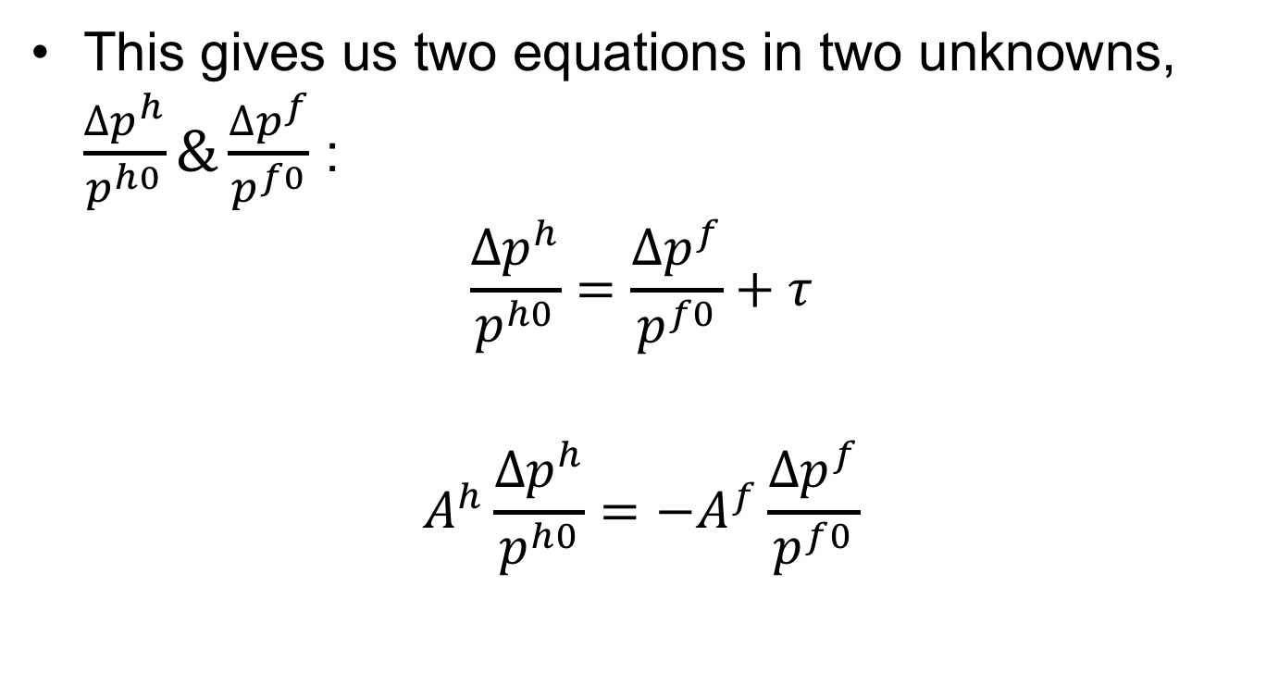
Two-Country in Equations
This gives us two equations in two unknowns, $\frac{{∆p}^{h}}{p^{h0}}\&\frac{{∆p}^{f}}{p^{f0}}$ :
$$\frac{{∆p}^{h}}{p^{h0}}=\frac{{∆p}^{f}}{p^{f0}}+τ$$
$$A^{h}\frac{{∆p}^{h}}{p^{h0}}={−A}^{f}\frac{{∆p}^{f}}{p^{f0}}$$

Slide 60
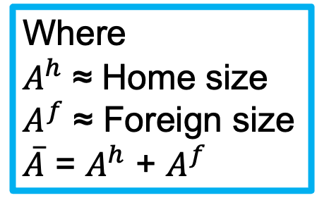
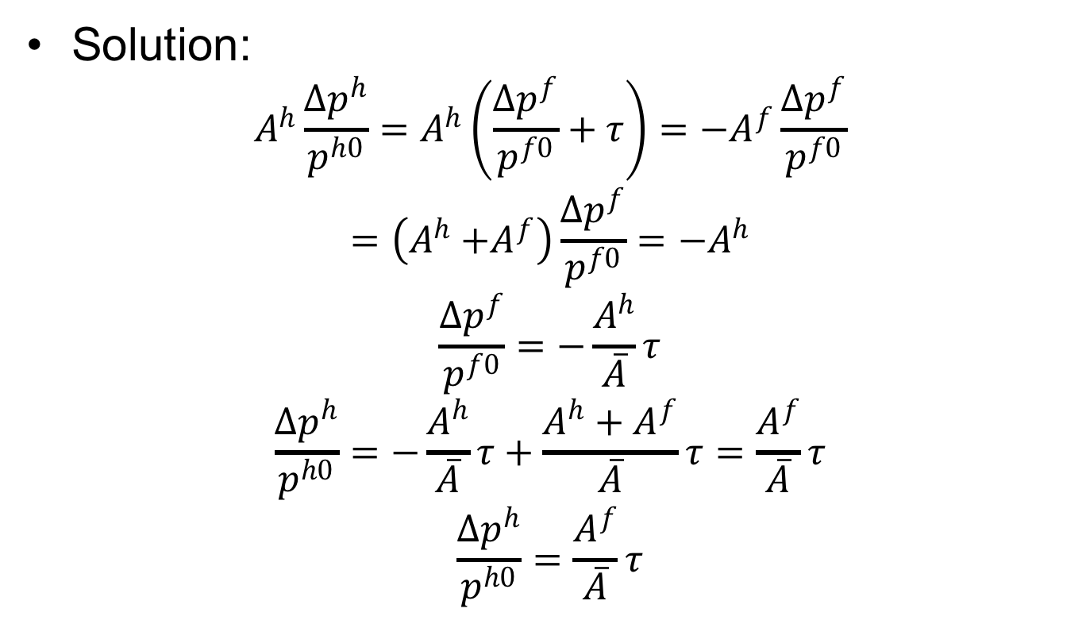
Two-Country in Equations
Solution:
$$A^{h}\frac{{∆p}^{h}}{p^{h0}}=A^{h}\left(\frac{{∆p}^{f}}{p^{f0}}+τ\right)={−A}^{f}\frac{{∆p}^{f}}{p^{f0}}$$
$$=\left(A^{h}{+A}^{f}\right)\frac{{∆p}^{f}}{p^{f0}}=−A^{h}$$
$$\frac{{∆p}^{f}}{p^{f0}}=−\frac{A^{h}}{\overline{A}}τ$$
$$\frac{{∆p}^{h}}{p^{h0}}=−\frac{A^{h}}{\overline{A}}τ+\frac{A^{h}+A^{f}}{\overline{A}}τ=\frac{A^{f}}{\overline{A}}τ$$
$$\frac{{∆p}^{h}}{p^{h0}}=\frac{A^{f}}{\overline{A}}τ$$
Where
$A^{h}$ ≈ Home size
$A^{f}$ ≈ Foreign size
$\overline{A}$ = $A^{h}$ + $A^{f}$

Slide 61
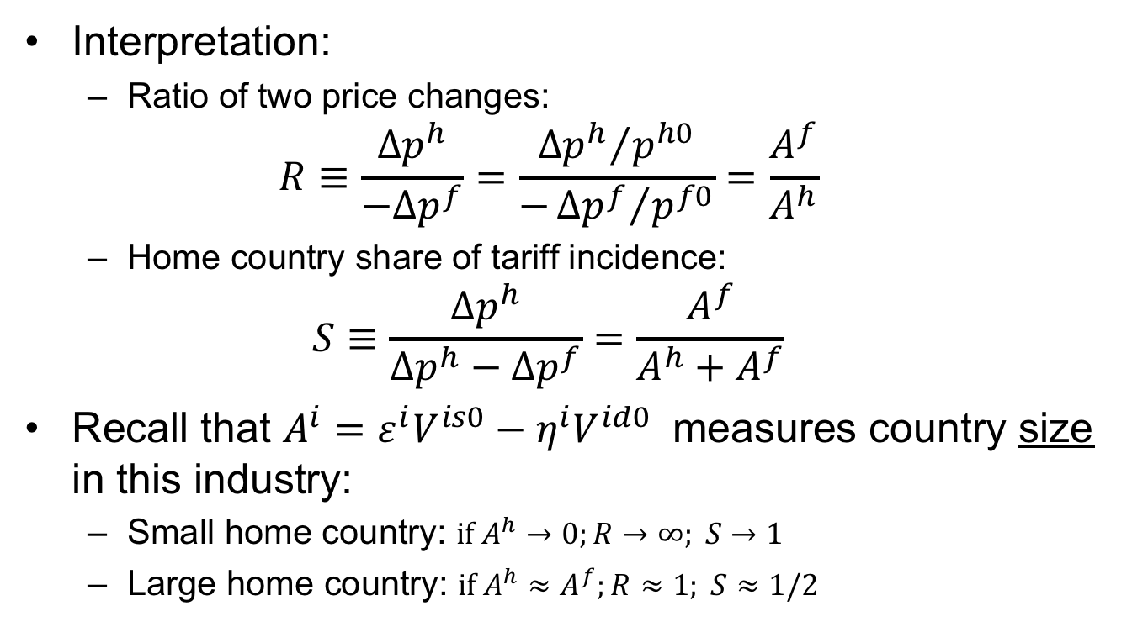
Two-Country in Equations
Interpretation:
  Ratio of two price changes:
  $$R≡\frac{{∆p}^{h}}{−{∆p}^{f}}=\frac{{{∆p}^{h}}/{p^{h0}}}{−{{∆p}^{f}}/{p^{f0}}}=\frac{A^{f}}{A^{h}}$$
  Home country share of tariff incidence:
  $$S≡\frac{{∆p}^{h}}{{∆p}^{h}−{∆p}^{f}}=\frac{A^{f}}{A^{h}+A^{f}}$$
Recall that $A^{i}=ε^{i}V^{is0}−η^{i}V^{id0}$ measures country size in this industry:
  Small home country: $if A^{h}→0;R→∞; S→1$
  Large home country: ${if A}^{h}≈A^{f};R≈1; S≈1/2$

Slide 62
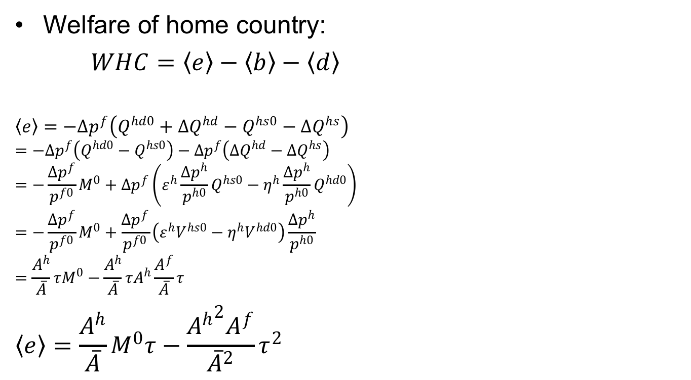
Two-Country in Equations
Home
P^{h}
S^{h}
Welfare of home country:
$WHC=〈e〉−〈b〉−〈d〉$
$$〈e〉=−{∆p}^{f}\left(Q^{hd0}+{∆Q}^{hd}−Q^{hs0}−{∆Q}^{hs}\right)$$
$$=−{∆p}^{f}\left(Q^{hd0}−Q^{hs0}\right)−{∆p}^{f}\left({∆Q}^{hd}−{∆Q}^{hs}\right)$$
$$=−\frac{{∆p}^{f}}{p^{f0}}M^{0}+{∆p}^{f}\left(ε^{h}\frac{{∆p}^{h}}{p^{h0}}Q^{hs0}−η^{h}\frac{{∆p}^{h}}{p^{h0}}Q^{hd0}\right)$$
$$=−\frac{{∆p}^{f}}{p^{f0}}M^{0}+\frac{{∆p}^{f}}{p^{f0}}\left(ε^{h}V^{hs0}−η^{h}V^{hd0}\right)\frac{{∆p}^{h}}{p^{h0}}$$
$$=\frac{A^{h}}{\overline{A}}τM^{0}−\frac{A^{h}}{\overline{A}}τA^{h}\frac{A^{f}}{\overline{A}}τ$$
$$〈e〉=\frac{A^{h}}{\overline{A}}M^{0}τ−\frac{{A^{h}}^{2}A^{f}}{{\overline{A}}^{2}}τ^{2}$$
P^{h1}
t
a
c
b
d
P^{h0}=P^{f0}
e
P^{f1}
Q^{hs0}
Q^{hd0}

Slide 63

Two-Country in Equations
Home
P^{h}
S^{h}
Welfare of home country:
$WHC=〈e〉−〈b〉−〈d〉$
$$〈b〉+〈d〉={∆p}^{h}\left({∆Q}^{hs}−{∆Q}^{hd}\right)/2$$
$$=\frac{{∆p}^{h}}{2p^{h0}}\left(ε^{h}\frac{{∆p}^{h}}{p^{h0}}{p^{h0}Q}^{hs0}−η^{h}\frac{{∆p}^{h}}{p^{h0}}{p^{h0}Q}^{hd0}\right)$$
$$=\frac{{∆p}^{h}}{2p^{h0}}\left(ε^{h}V^{hs0}−η^{h}V^{hd0}\right)\frac{{∆p}^{h}}{p^{h0}}$$
$=\frac{1}{2}A^{h}{\left(\frac{{∆p}^{h}}{p^{h0}}\right)}^{2}$ $=\frac{1}{2}A^{h}{\left(\frac{A^{f}}{\overline{A}}τ\right)}^{2}$
$$〈b〉+〈d〉=\frac{{{A^{h}A}^{f}}^{2}}{{2\overline{A}}^{2}}τ^{2}$$
P^{h1}
t
a
c
b
d
P^{h0}=P^{f0}
e
P^{f1}
Q^{hs0}
Q^{hd0}

Slide 64


Welfare of Home Country
$WHC=〈e〉−\left(〈b〉+〈d〉\right)=\left[\frac{A^{h}}{\overline{A}}M^{0}τ−\frac{{A^{h}}^{2}A^{f}}{{\overline{A}}^{2}}τ^{2}\right]−\frac{{{A^{h}A}^{f}}^{2}}{{2\overline{A}}^{2}}τ^{2}$
Welfare
P
P_{aut}
b
XS*
c
P₁
a
b
t
c
d
$τ$_{opt}
$τ$
P*₁
MD
c–b
P_{aut}*
M₁=X*₁
M₀=X*₀
M,X*
P_{aut}–P_{aut}*

Slide 65
Two-Country in Equations
Other effects can be calculated similarly from the areas in the figure:
Home
World
Foreign
P^{h}
P
P^{f}
S^{h}
XS*
S^{f}
P^{h1}
D^{f}
P^{h1}
t
a
c
t
c
b
d
f
P^{h0}=P^{f0}
e
g
i
j
e
h
e
P^{f1}
P^{f1}
P^{f1}
D^{h}
MD
Q^{hs0}
Q^{hd0}
Q^{h}
M₀=X*₀
M,X*
Q^{fs0}
Q^{fd0}
Q^{f}

Slide 66
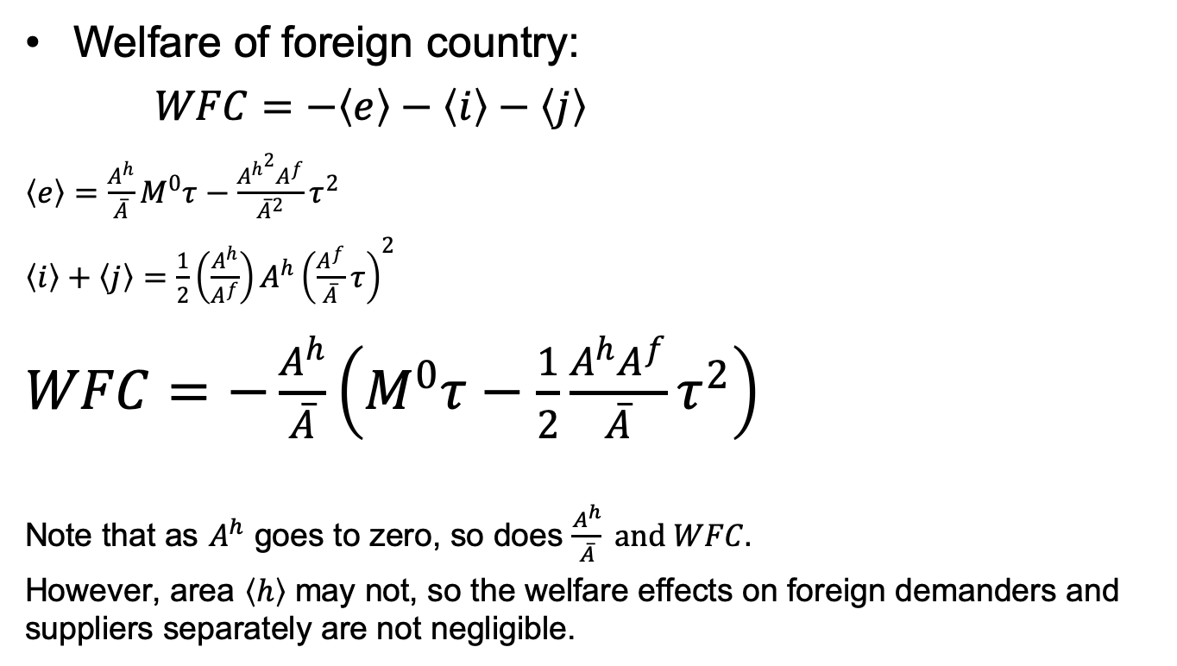
Two-Country in Equations
Foreign
P^{f}
Welfare of foreign country:
$WFC=−〈e〉−〈i〉−〈j〉$
$〈e〉=\frac{A^{h}}{\overline{A}}M^{0}τ−\frac{{A^{h}}^{2}A^{f}}{{\overline{A}}^{2}}τ^{2}$
$〈i〉+〈j〉=\frac{1}{2}\left(\frac{A^{h}}{A^{f}}\right)A^{h}{\left(\frac{A^{f}}{\overline{A}}τ\right)}^{2}$
$WFC=−\frac{A^{h}}{\overline{A}}\left(M^{0}τ−\frac{1}{2}\frac{A^{h}A^{f}}{\overline{A}}τ^{2}\right)$
Note that as $A^{h}$ goes to zero, so does $\frac{A^{h}}{\overline{A}} and WFC.$
However, area $〈h〉$ may not, so the welfare effects on foreign demanders and suppliers separately are not negligible.
S^{f}
D^{f}
P^{h0}=P^{f0}
i
j
h
e
P^{f1}
Q^{fs0}
Q^{fd0}
Q^{f}

Slide 67
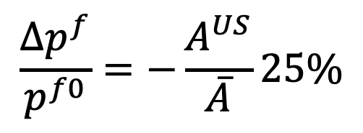

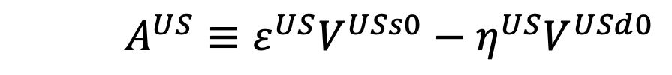
Is the US a Large Country?
Consider Trump’s 25% tariff on steel
So
  Foreign price of steel should fall by 25% times the US share of the world market
  US price of steel should rise by 25% of the foreign share of the world market
$$\frac{{∆p}^{f}}{p^{f0}}=−\frac{A^{US}}{\overline{A}}25\%$$
$A^{US}≡ε^{US}V^{USs0}−η^{US}V^{USd0}$
${\overline{A}=A}^{US}+A^{f}$

Slide 68
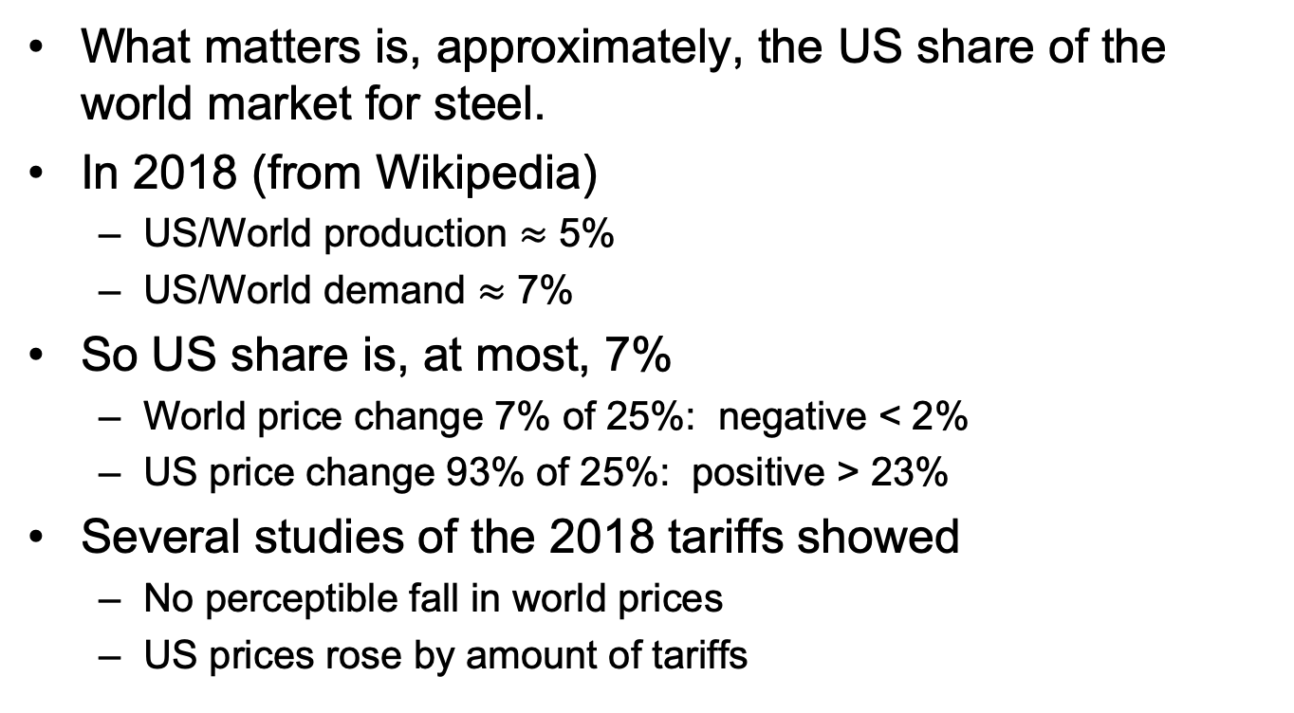
Is the US a Large Country?
What matters is, approximately, the US share of the world market for steel.
In 2018 (from Wikipedia)
  US/World production $≈$ 5%
  US/World demand $≈$ 7%
So US share is, at most, 7%
  World price change 7% of 25%: negative < 2%
  US price change 93% of 25%: positive > 23%
Several studies of the 2018 tariffs showed
  No perceptible fall in world prices
  US prices rose by amount of tariffs

Slide 69
Pause for Your Questions

Slide 70
Quotas
Quota puts upper limit on quantity of imports
Analysis is exactly the same as a tariff, except
  Policy sets quantity of imports
  Price difference is determined by the market (supply & demand)
  Price difference is called “tariff equivalent” of the quota
Welfare analysis of quota is the same as tariff, except
  “Quota rent” instead of tariff revenue
Who gets the quota rent?
  Depends on how quota is administered
  Most commonly, goes to foreigners

Slide 71
Small country quota
(with rents to foreigners)
P
Welfare effects of a quota,q, starting from free trade
  Suppliers gain +a
  Demanders Lose −(a+b+c+d)
  Government gains nothing
  Country loses −(b+c+d)
S
P_{aut}
P₁=P_{W}+t^{eq}
t^{eq}
a
c
b
d
P₀=P_{W}
Foreign gains quota rent +c
  But this is negligible for world, since country is small
D
q =M₁
S₀
S₁
D₁
D₀
Q
M₀
World dead-weight loss is still b+d
Quota q

Slide 72
Large country quota
(with rents to foreigners)
Welfare effects of a large-country quota, starting from free trade
Home:
  Private sector (S&D) loses −(a+b)
  Government gains 0
  Country must lose: −(a+b)
Foreign:
  Private sector (S&D) loses −(c+d)
  Foreigners gain rents +(a+c)
  Country may gain or lose +a−d
World loses −(b+d)
World Market
Home is Importer
Foreign (*) is Exporter
P
XS*
P₁
a
b
t^{eq}
c
d
P*₁
MD
Q=M₁=X*₁
M₀=X*₀
M,X*
“Dead Weight Loss” =

Slide 73
Pause for Discussion

Slide 74
  Questions on Quotas
How might quotas be administered; what happens to the quota rents in each case?
How is an import quota equivalent to a tariff? How is it not?
With a fixed and binding import quota, how will the domestic price and the tariff-equivalent of the quota change if curves shift?

Slide 75
Recent Tariff Threats
I’m not finding much on this, unlike last year.
  UK threatens new tariffs on US
    Reuters, 5/24/21: “UK proposes new tariffs on U.S. wines and lobsters” (Due to US tariffs on steel & Aluminum)
  US continues to threaten tariffs against digital taxes.
    FT, 6/2/21: “US wields $2bn tariff threat against 6 nations over digital taxes”
  Trump threatened Vietnam with tariff due to its weak currency.
    Reuters, 7/24/21: “U.S. trade agency drops tariff threat against Vietnam over currency practices”

